Slide 1


LEAD SCORE CASE STUDY
Logistic Regression

Slide 2
PROBLEM STATEMENT
X Education is an organization which provides online course for industry professional. The company marks its courses on several popular websites like google.
X Education wants to select most promising leads that can be converted to paying customer.
Although company generates a lot of leads only few are converted into paying customers, wherein the company wants higher lead conversion. Leads come through numerous modes like email, advertisements on websites, google searches etc.
The company has had 30% conversion rate through the whole process of turning leads into customers by approaching those leads which are to be found having interest in taking the course. The implementation process of lead generating attributes arwe not efficient in helping conversions.

Slide 3
STRATEGY
Import data
Clean and prepare acquired data for further analysis
Exploratory data analysis for figuring out most helpful attributes for conversion
Prepare the data model building
Build a logistic regression model
Assign a lead score for each leads
Test the model on train set
Evaluate model by different measures ad metrics.
Test the model on test set
Measure the accuracy of model and other metrics for evaluation

Slide 4
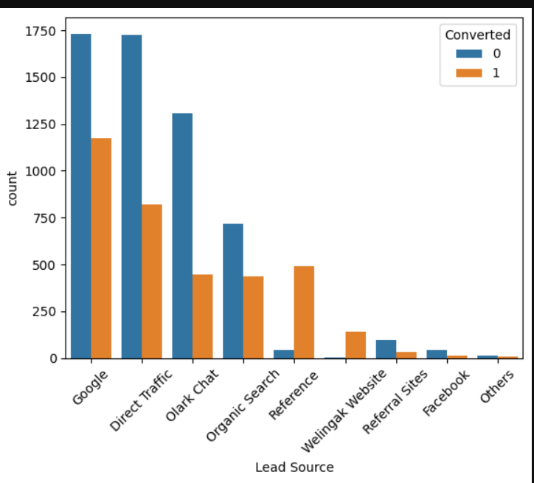
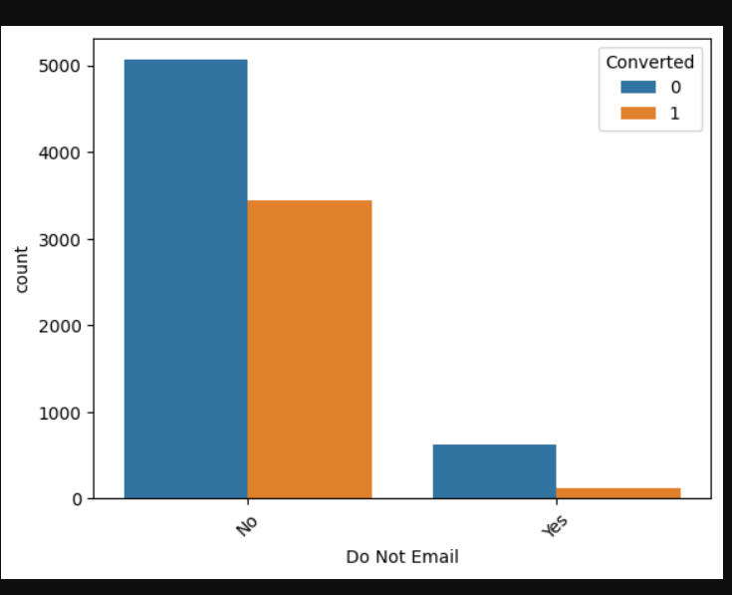
ERD
LEAD SOURCE VS CONVERTED
Google searches has had high conversion rate as compared to others lead source.
Do Not Email VS CONVERTED
Google searches has had high conversions compared to other modes, whilst references has had high conversion rate.

Slide 5
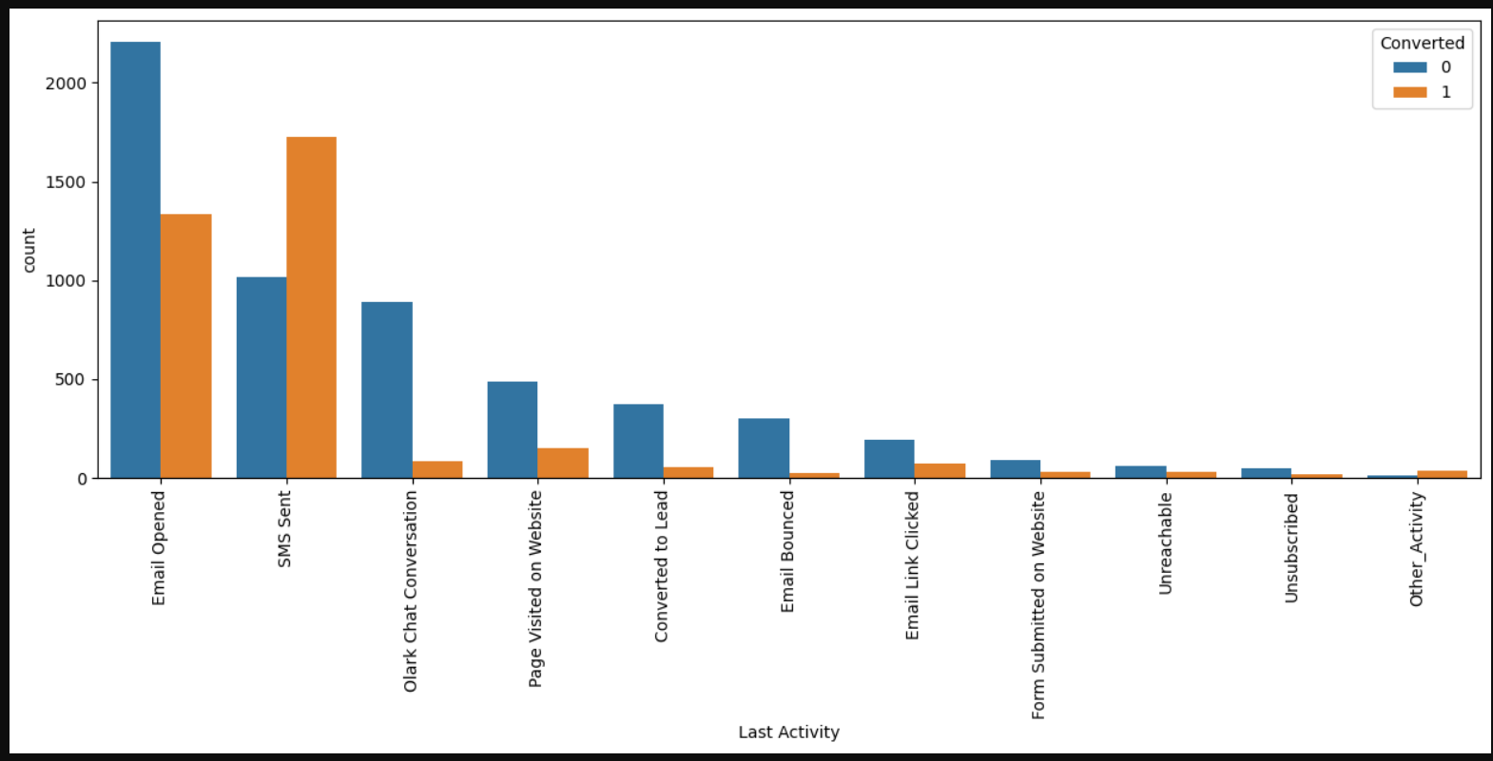
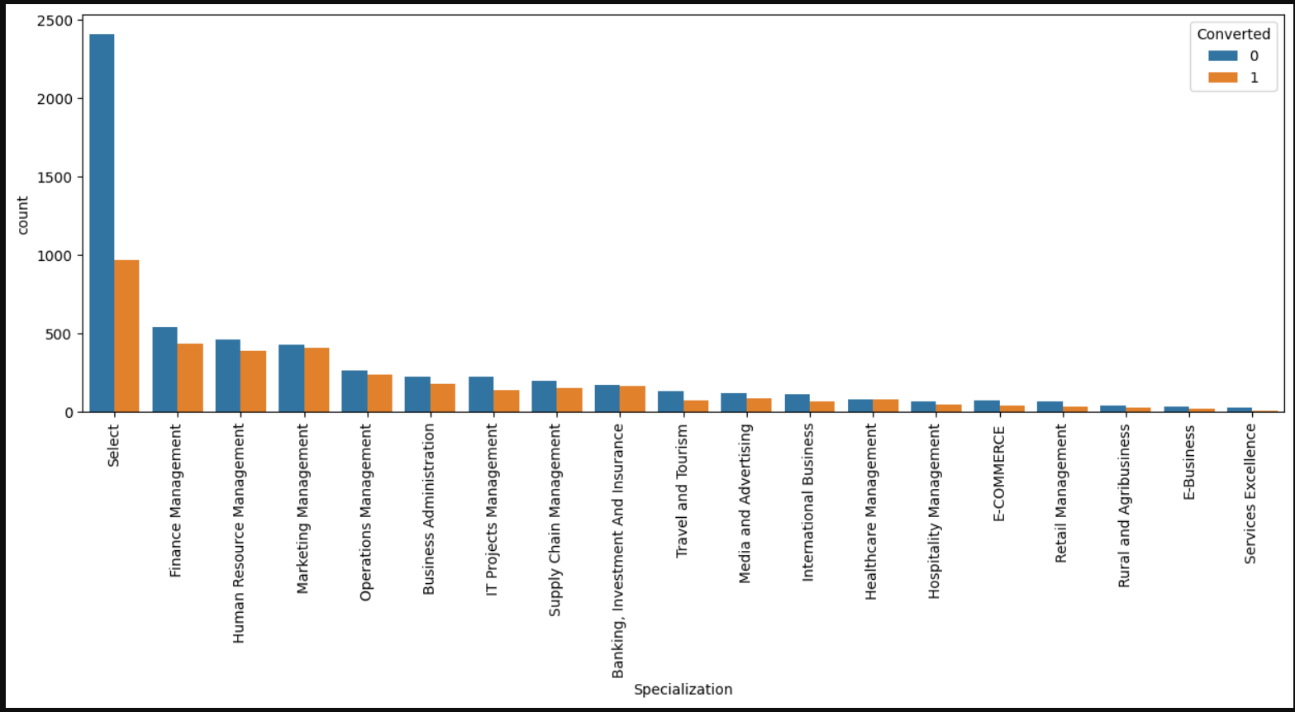
Last activity VS CONVERTED
SMS has shown to be a promising method for getting higher confirmed leads, emails also has high conversions.
SPECIALIZATION VS CONVERTED
Finace management ,marketing management, human resources management has high conversion rates. People from these specializations can be promising leads

Slide 6
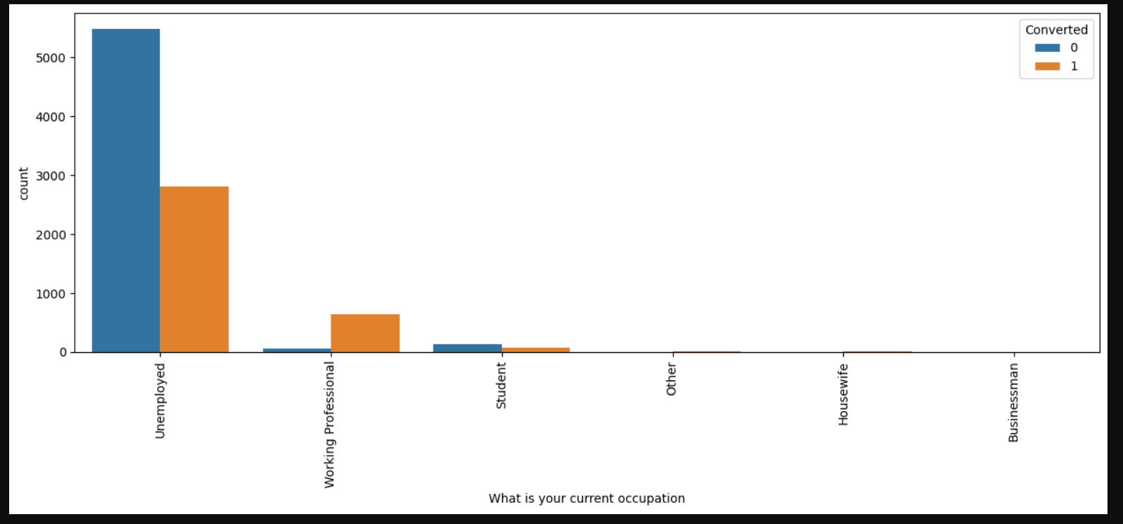
Current Occupation VS CONVERTED
Unemployment has shown to be a promising method for getting higher confirmed leads.
Do Not Call VS CONVERTED
Most leads prefer not to informed through phone.

Slide 7
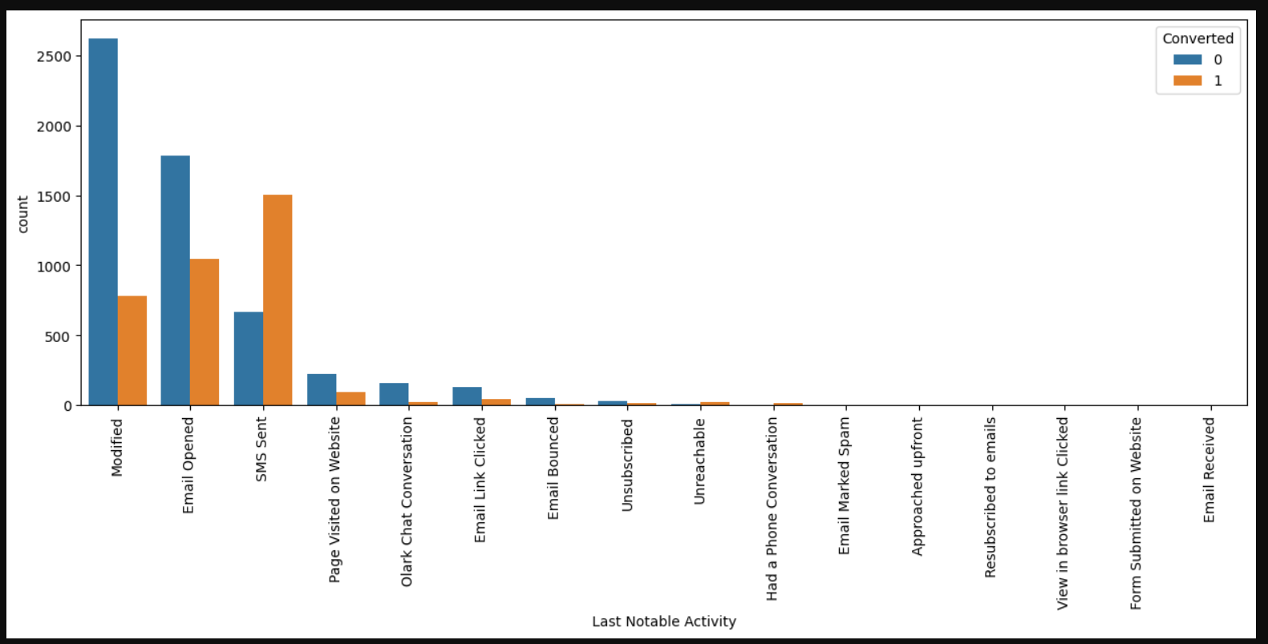
Current Occupation VS CONVERTED
Unemployment has shown to be a promising method for getting higher confirmed leads.
LAST NOTABLE ACTIVITY VS CONVERTED
Most leads are converted with messages. Emails also induce leads.

Slide 8
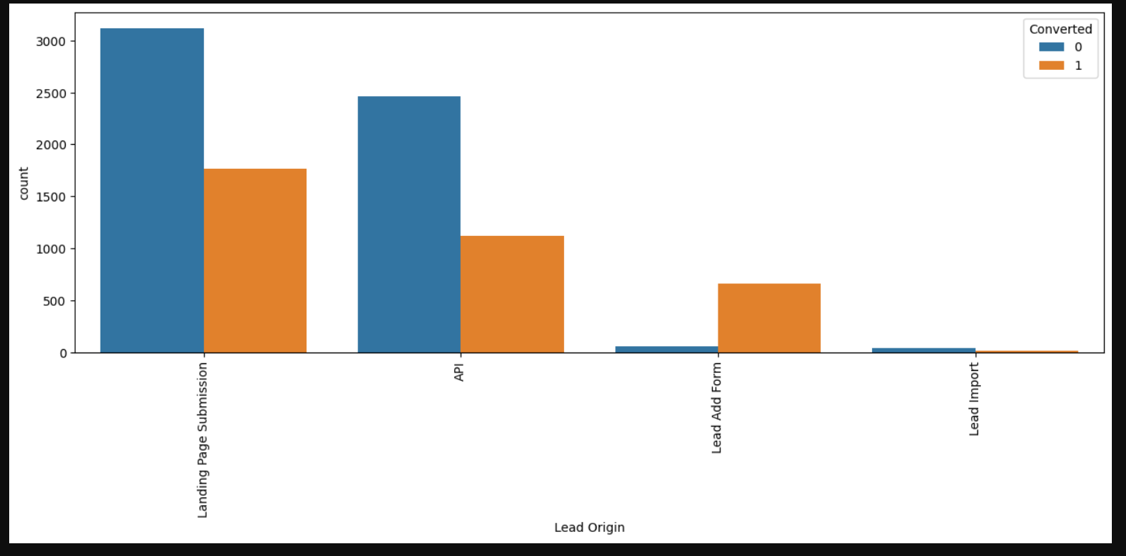
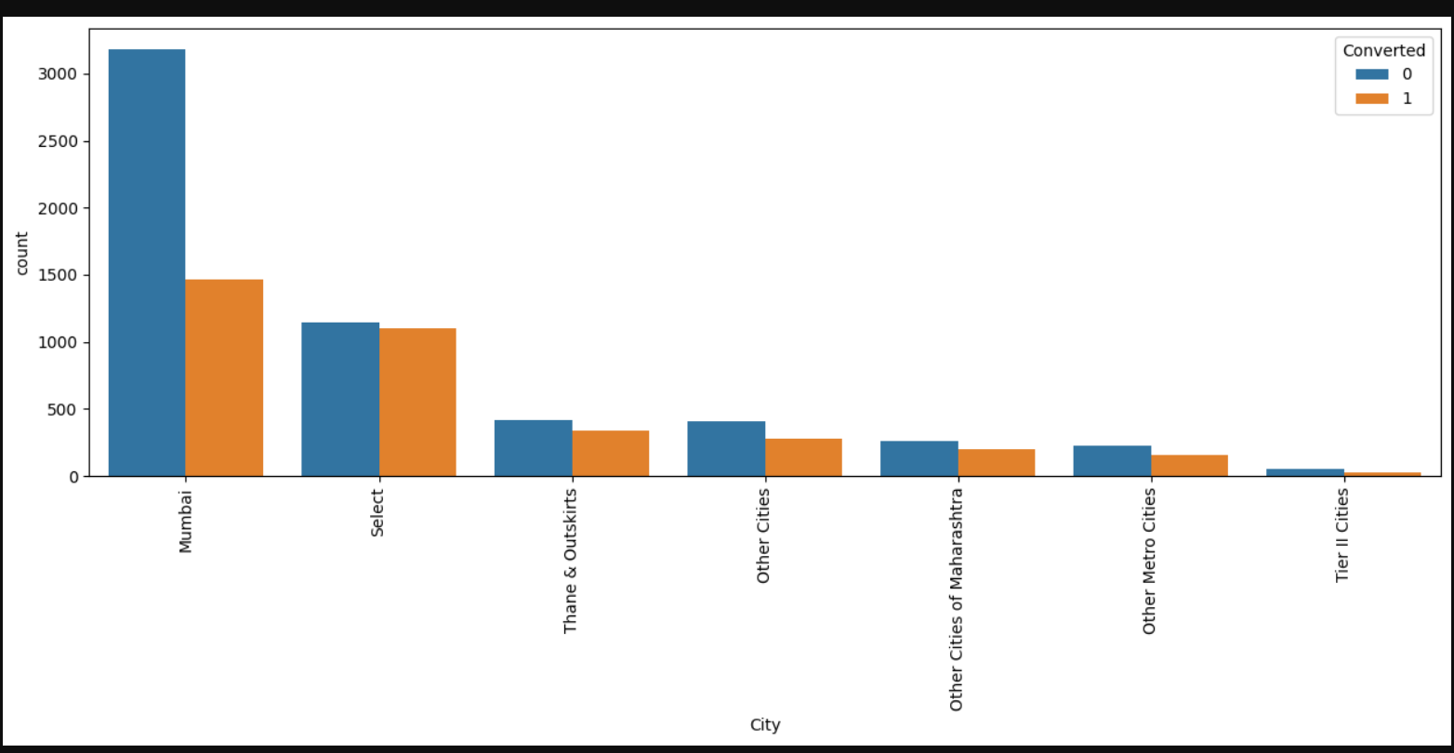
LEAD ORIGIN VS CONVERTED
Landing page submissions has had high lead conversions
CITY VS CONCERTED
Mumbai city has had high lead conversions.

Slide 9
MODEL BUILDING
Splitting into train and test set Scale variables in train set Build the first model Use RFE to eliminate less relevant variables Build the next model Eliminate variables based on high p-values Check VIF value for all the existing columns Predict using train set Evaluate accuracy and other metric Predict using test set Precision and recall analysis on test predictions.

Slide 10
CONCLUSION
People spending higher than average time are promising leads, so targeting them and approaching them can be helpful in conversions SMS messages can have a high impact on lead conversion landing page submissions can help find out more leads Marketing management, human resources management has high conversion rates. People from these specializations can be promising leads* References and offers for referring a lead can be good source for higher conversions An alert messages or information has seen to have high lead conversion rate Logistic Regression Model: The model shows high close to 81% accuracy The threshold has been selected from Accuracy, Sensitivity, specificity measures and precision, recall curves. The model shows 76% sensitivity and 83% specificity* The model finds correct promising leads and leads that have less chances of getting converted Overall this model proves to be accurate.

